Slide 1
Dept of Information Technology A Comprehensive Bus Management System with Advanced Functionality.
Guide : Mr.D.Sandeep Assistant Professor
Batch No :
Team Members :
22R21A12F1 : G.Venu
22R21A12H5 : P.Srikanth
22R21A12D2 : A.Rajesh
22R21A12H1 : M.Harsha

Slide 2
INTRODUCTION
The BMS streamlines pass issuance processes, offering flexible options for passengers, whether it's daily commuter passes, monthly subscriptions, or special event passes. Additionally, it optimizes bus schedules through advanced algorithms and real-time data analytics, ensuring efficient resource utilization and minimizing delays.
The BMS ensures secure access with user and admin authentication features. It provides real-time bus tracking for both administrators and passengers, facilitates student information management for educational institutions, and integrates a payment gateway for convenient and secure fare payments.

Slide 3
ABSTRACT
The Bus Management System (BMS) integrates cutting-edge technologies to deliver a seamless and efficient transportation solution. Utilizing web technologies such as HTML, CSS, and JavaScript, alongside frameworks like React.js or Angular.js, the system provides a user-friendly interface for functionalities such as pass issuance, bus scheduling, and student information management. Backend operations are powered by server-side languages such as Python or Node.js, coupled with relational database management systems like MySQL or PostgreSQL for robust data handling. Real-time bus tracking, enabled by GPS technology, ensures accurate location updates, while authentication mechanisms utilizing JSON Web Tokens (JWT) guarantee secure access for both users and administrators. Integration with payment gateways further enhances the system's convenience, allowing users to make online payments seamlessly. This comprehensive approach leverages modern technology to optimize bus transportation within educational institutions or corporate settings, enhancing efficiency and user experience.

Slide 4
OBJECTIVES
The primary objective of the Bus Management System project is to develop a comprehensive solution for optimizing bus operations and enhancing passenger experiences. This involves streamlining pass issuance processes, offering flexible options for passengers, and optimizing bus schedules to ensure efficient resource utilization and minimize delays.
The project aims to enhance user experiences for both passengers and administrators by integrating advanced features such as user and admin authentication, real-time bus tracking, student information management, and payment gateway integration. These features are designed to improve convenience, security, and transparency in bus operations, ultimately leading to a more seamless transportation experience for all stakeholders..

Slide 5
EXISTING SYSTEM
Many existing systems are complex to implement and maintain, requiring significant training and resources, which can be costly for organizations with limited budgets.
Some systems lack flexibility and scalability, making it challenging to customize them to specific needs or adapt to growth and changes over time.
Issues with reliability, performance, and integration can undermine user trust and satisfaction, leading to disruptions in service delivery and inefficient workflows.

Slide 6
PROPOSED SYSTEM
Our system offers pass issuance, bus scheduling, user authentication, tracking, student management, and payment integration. Powered by algorithms like route optimization and real-time tracking.
We optimize operations using algorithms such as genetic algorithms for route planning and machine learning for demand prediction, reducing delays and maximizing resources.
Intuitive interfaces and seamless interactions facilitated by user-friendly algorithms ensure a smooth experience for passengers and administrators.
Modular architecture and scalable algorithms allow for easy customization and growth to meet evolving needs and environments.
With encryption and redundancy algorithms, our system ensures data integrity and confidentiality, fostering trust among users.

Slide 7
SYSTEM REQUIREMENTS
Hardware Requirements
Processor : i5
RAM : 8GB
Hard Disk : 540GB
Software Requirements
Operating System : Windows
Programming Language : Java, Python, JavaScript (Node.js), SQL, HTML/CSS, PHP

Slide 8
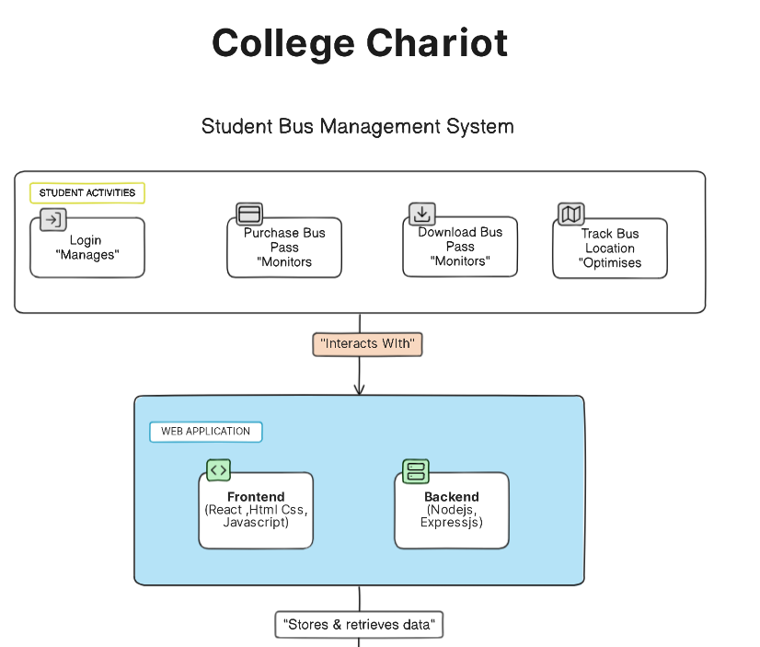
Data Flow Diagram

Slide 9
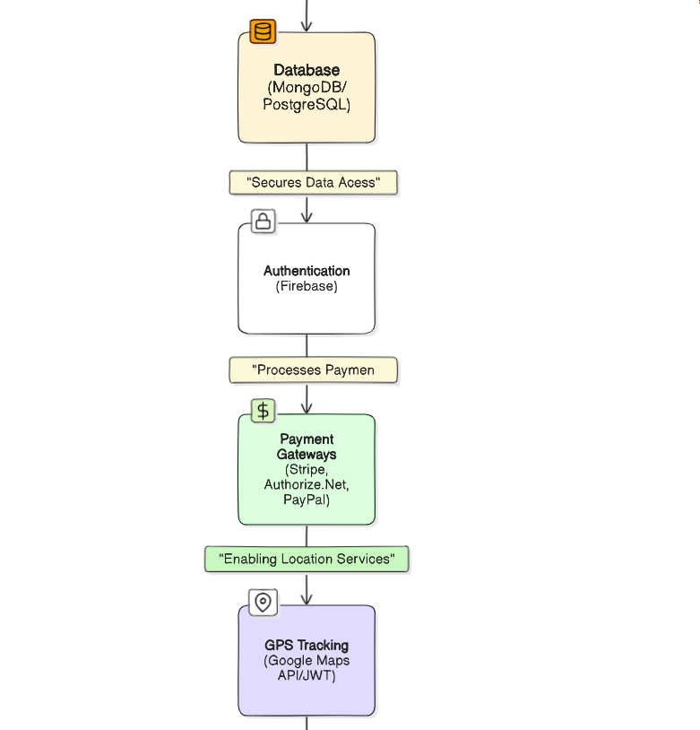

Slide 10
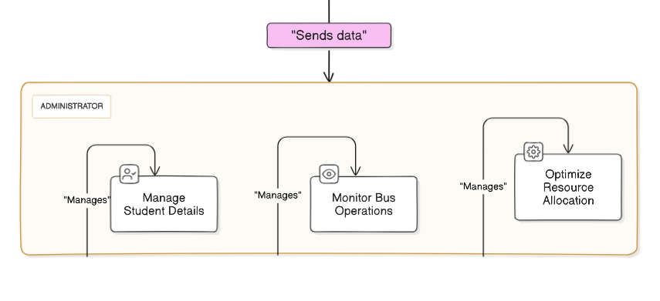

Slide 11
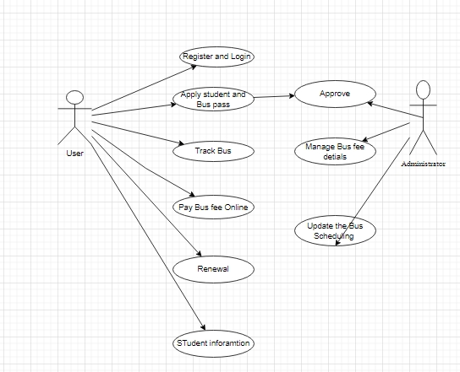
Use Case Diagram

Slide 12
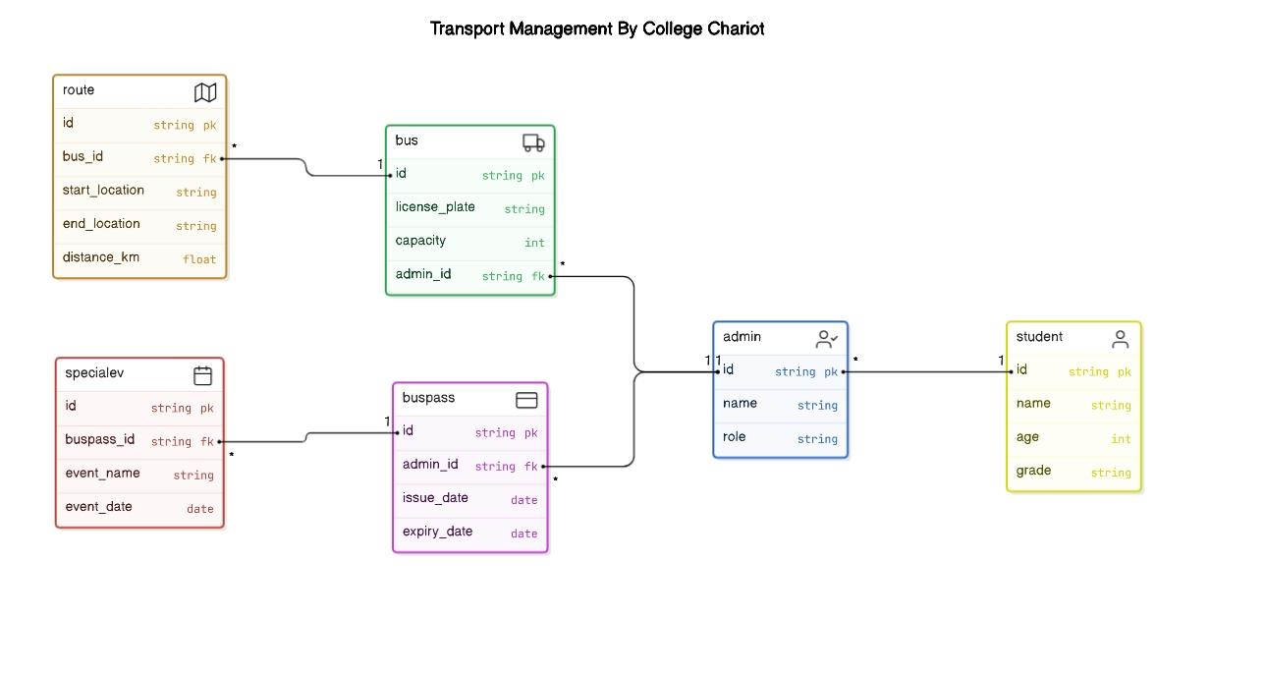

Slide 13
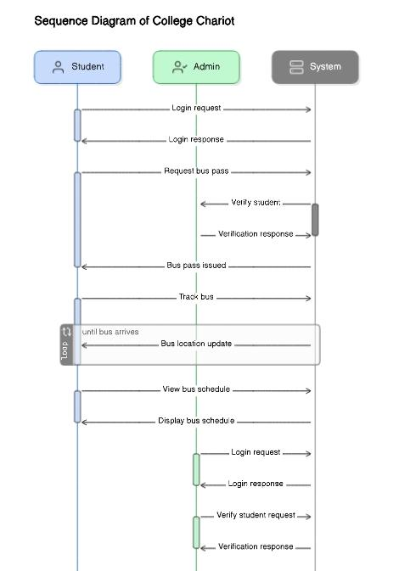

Slide 14
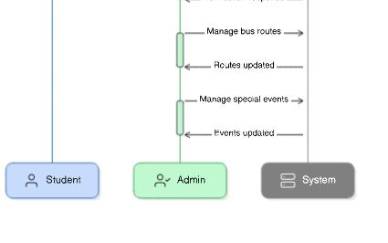

Slide 15
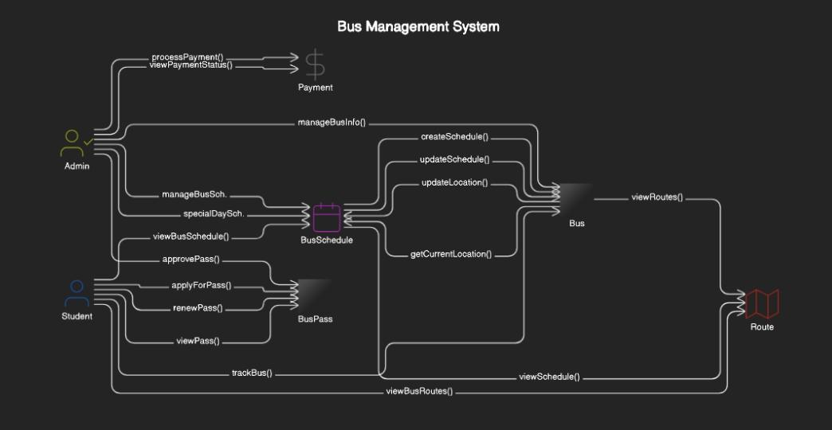

Slide 16
Conclusion
In conclusion, our college bus management system offers a comprehensive solution to streamline transportation for students and administrators alike. With its user-friendly online platform for purchasing digital bus passes, real-time bus tracking capabilities, and detailed route information, this system aims to revolutionize the college commuting experience. By leveraging modern technology, we strive to enhance efficiency, accessibility, and sustainability within our campus community, fostering a seamless and interconnected transportation ecosystem

Slide 17


